Slide 1

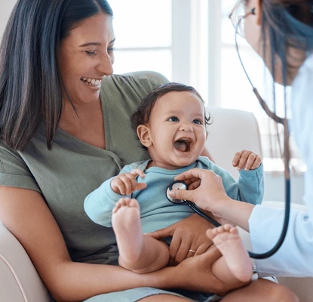

DA User Journey
Updated 22 Jan 2026
Notes:
Ref: https://docs.google.com/presentation/d/1libK6QabR1DrhQZF0sdoUm2jki4w2AWx/edit#slide=id.p3

Slide 2
APP

Slide 3
SUMMARY DA SERVICES & USER JOURNEY
VIRTUAL CONSULT (VC)
Book and join VC service via app
Also can Book via web (info page)→ download app → join VC
Service received via App
VACCINATION
Book via App → DA Market Place (mobile web)
Book via Web→ (has more info on types of vaccine) Booking based on type of Vaccinnes
Service received via In-clinic or Home-based
HOME-BASED CARE /(MOBS) (DOCTOR HOUSE CALL)
Book Via app → DA Marketplace (mobile web) → Booking Form (incognito)
Book via web (has More infor) → Booking form (incognito)
Service via Home-based
Services offer: Vaccination, Health Screening, Wound dressing, etc
HEALTH SCREENING
Book via app → DA Market Place (mobile web) and fill form
Book via web (info page)→ fill up form
Services via In-clinic or via home-based

Slide 4
5. KIDS CLINIC
Services under Kids Clinic are VC + Flu Vaccination
VC: Book and service via app
Book via web (info page)→ download app
Service received via App
Vaccination: Book via App thru DA Market Place (mobile-web)
Book via Web (have more info on types of vaccines)
Service via DA In-clinic or DA Home-based
Kids Clinic “dedicated tile” in app https://doctoranywhere.sng.link/Avkkq/9v17/r8a4
6. WOMEN’S HEALTH
7. MEDSUITES (CENTER AT ORCHARD RD).
Book health screenings via web
Book some packages via DA Market Place

Slide 5
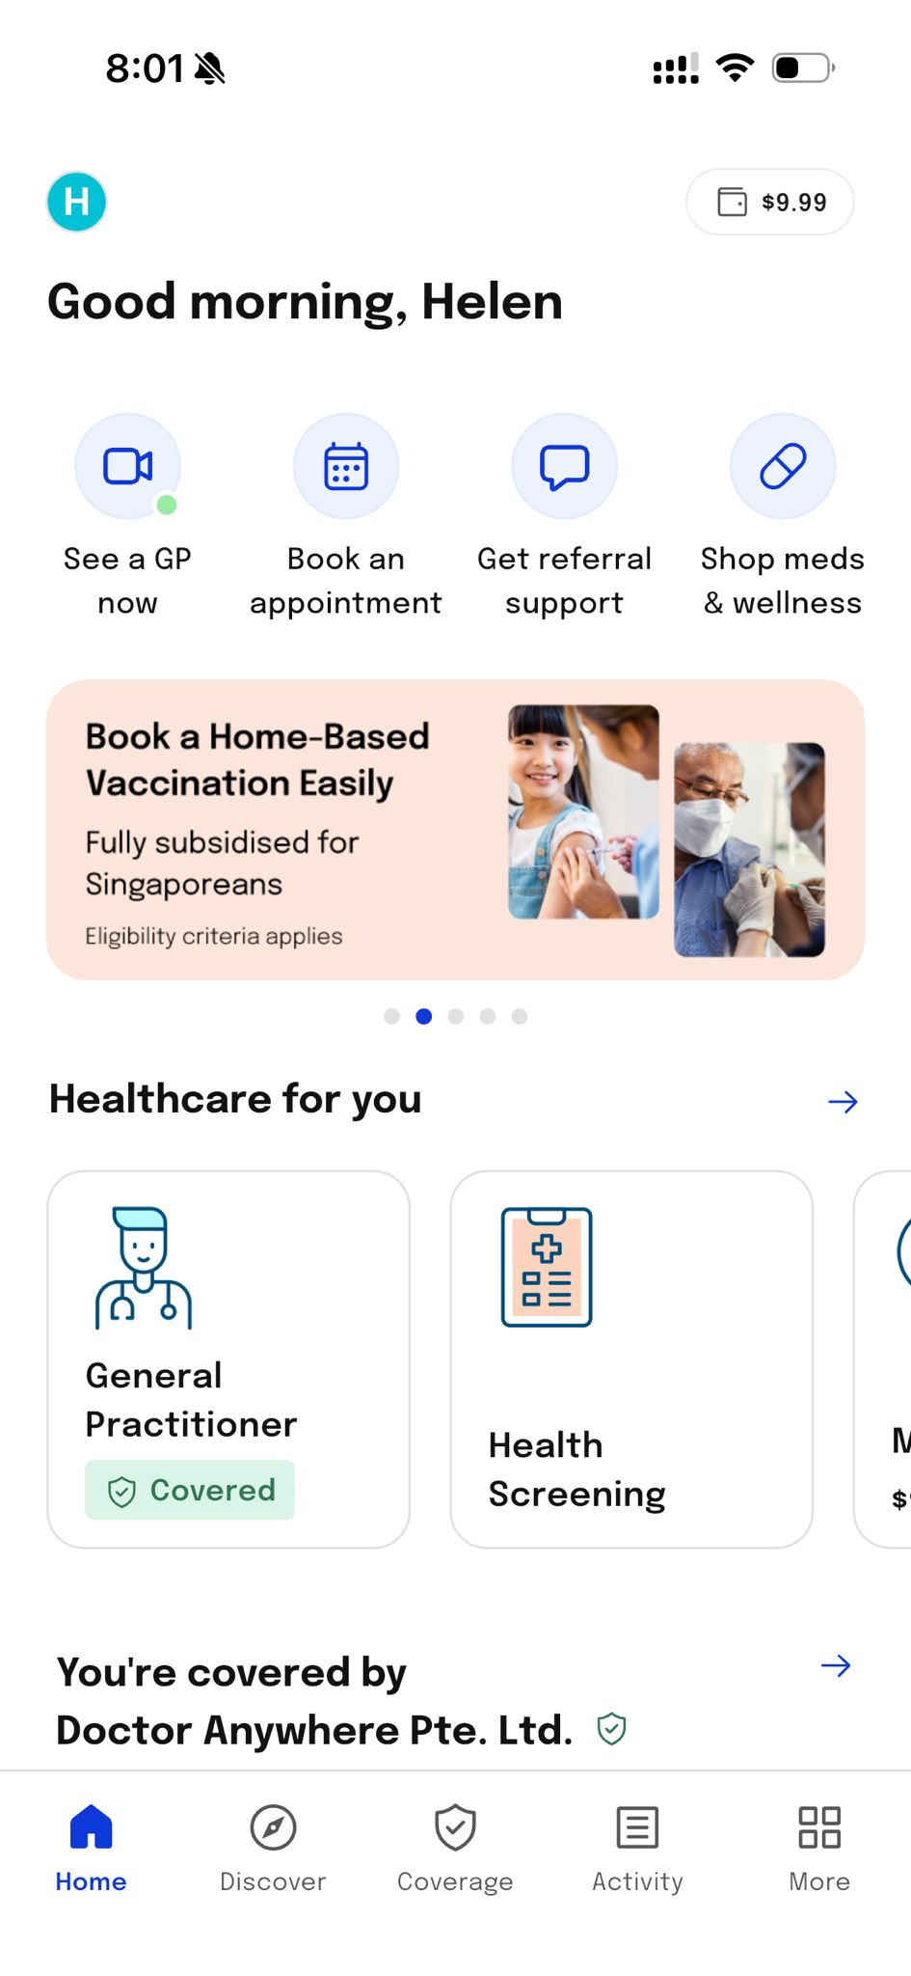
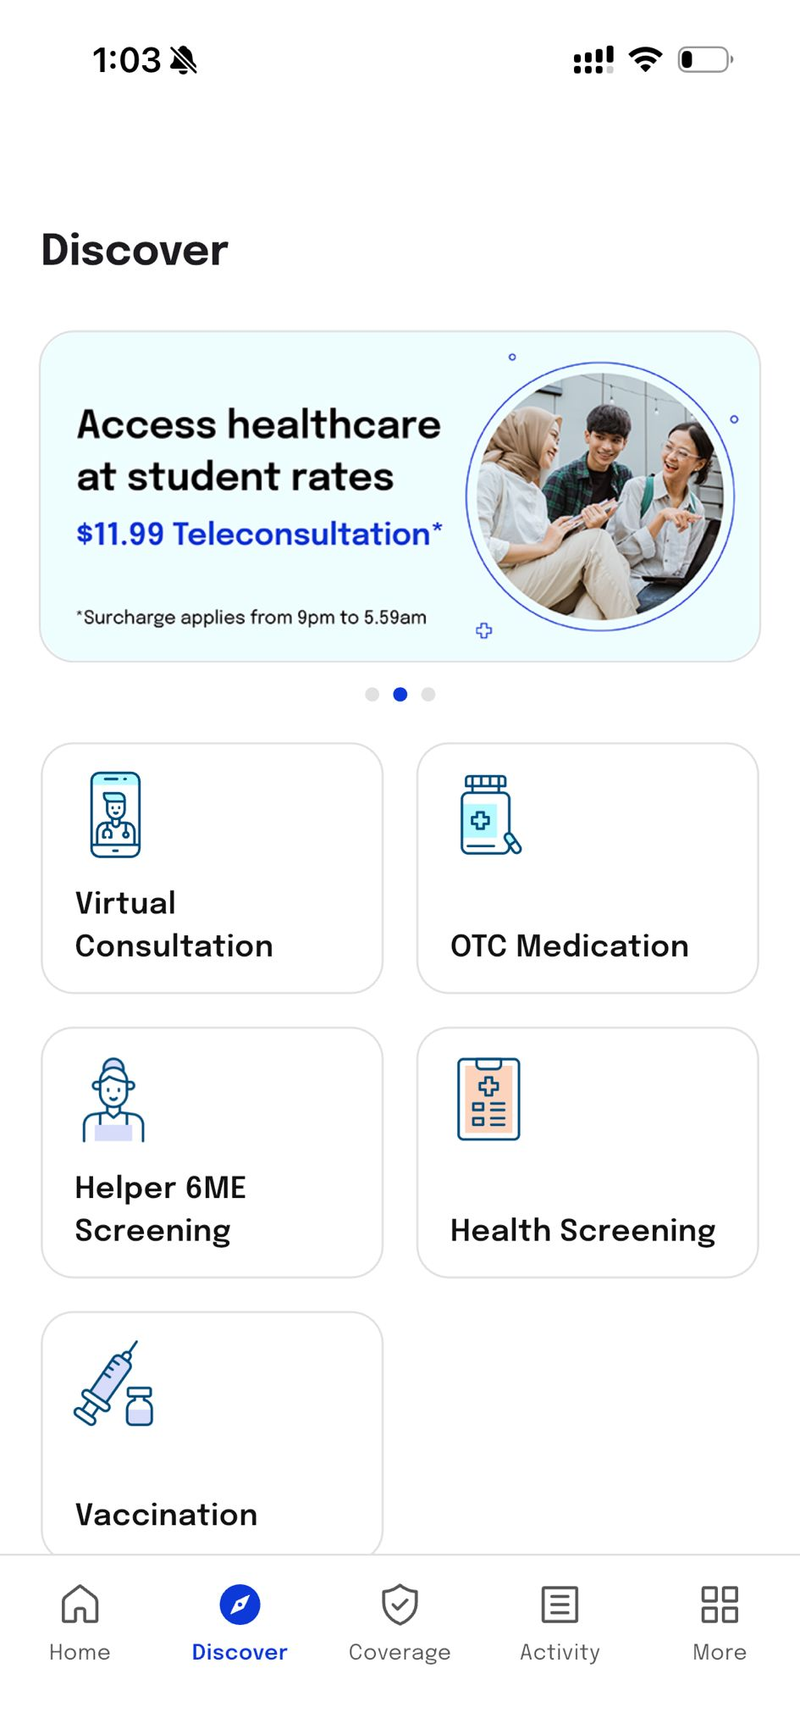
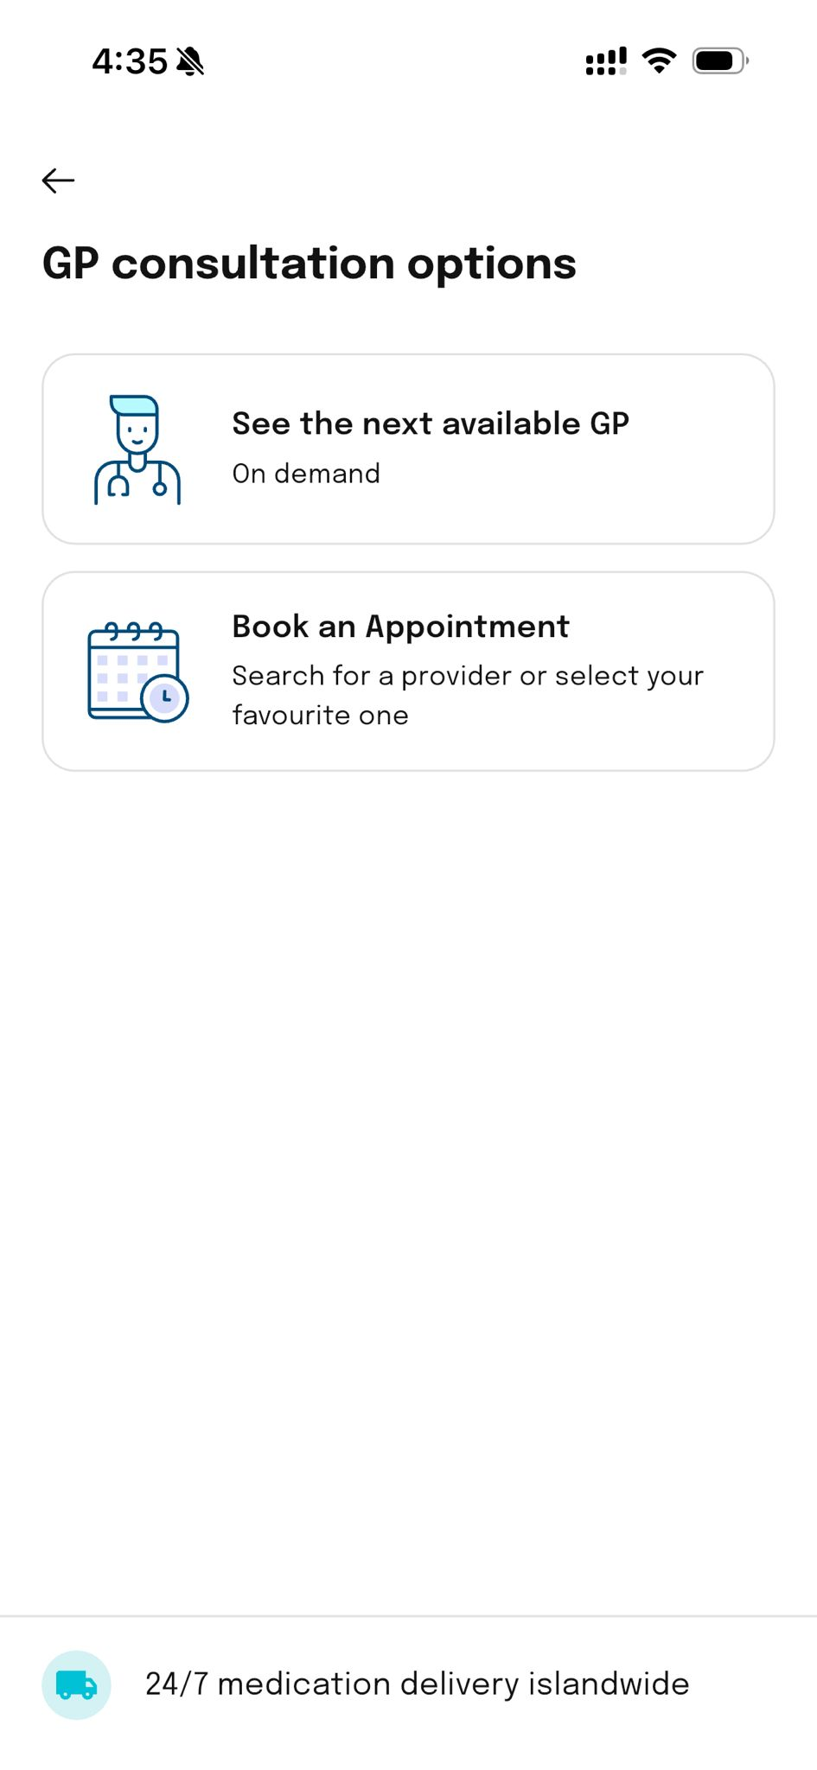
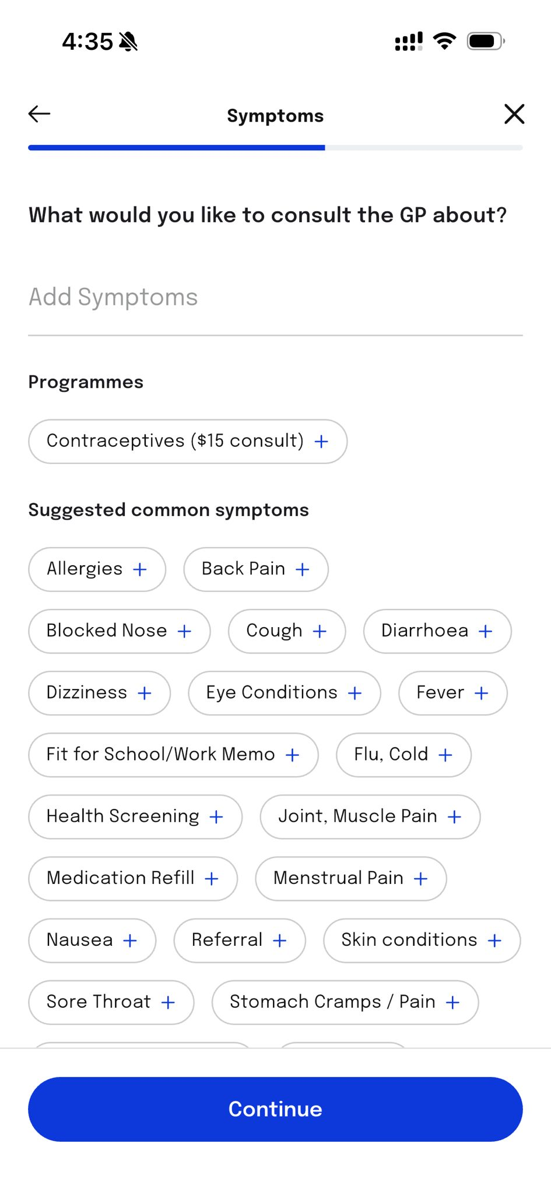
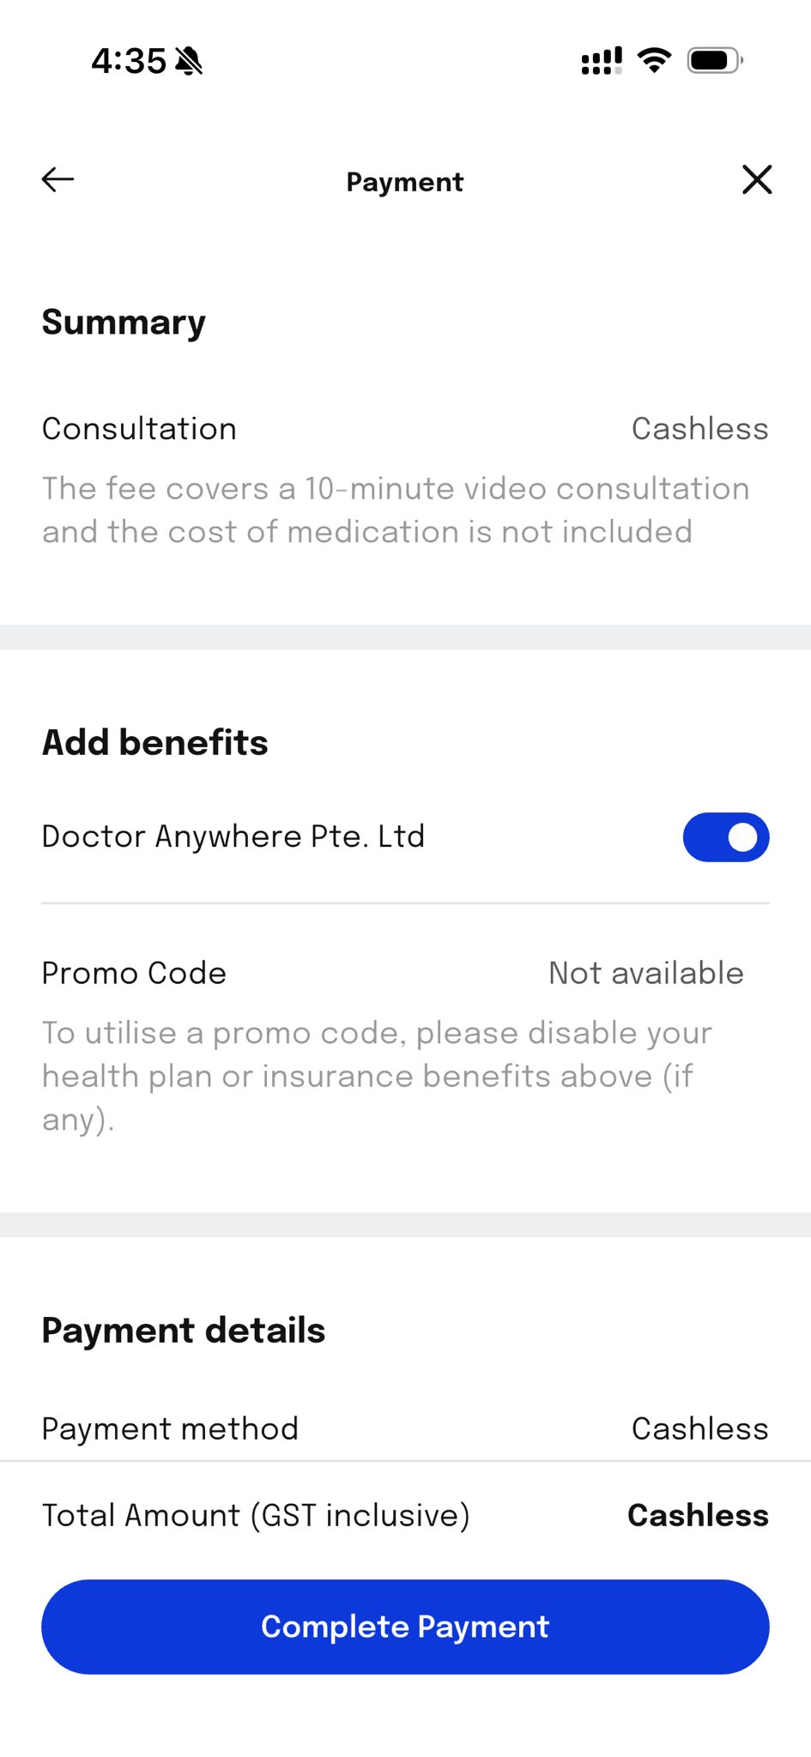
VC USER JOURNEY- IN APP

Slide 6
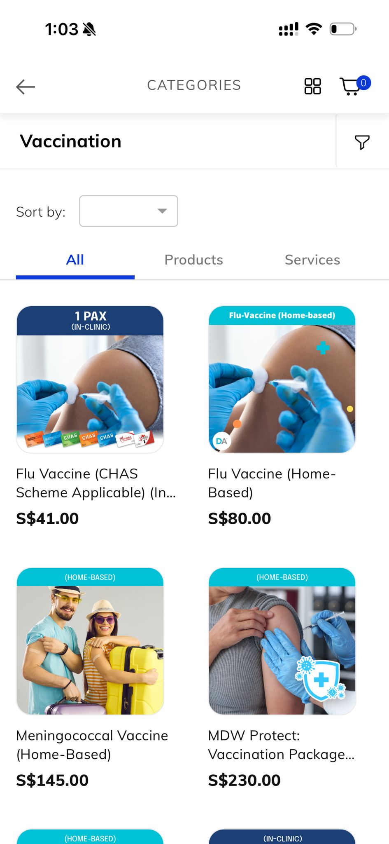
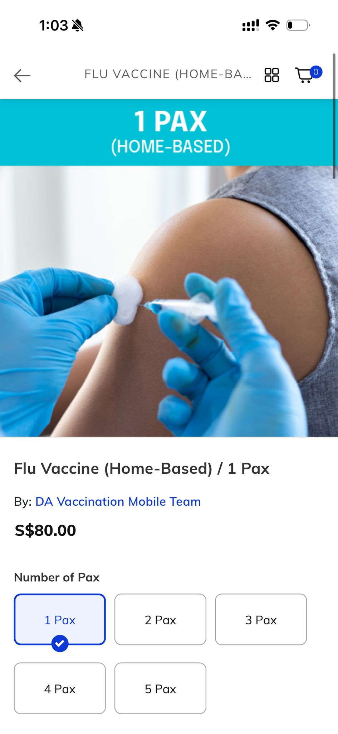
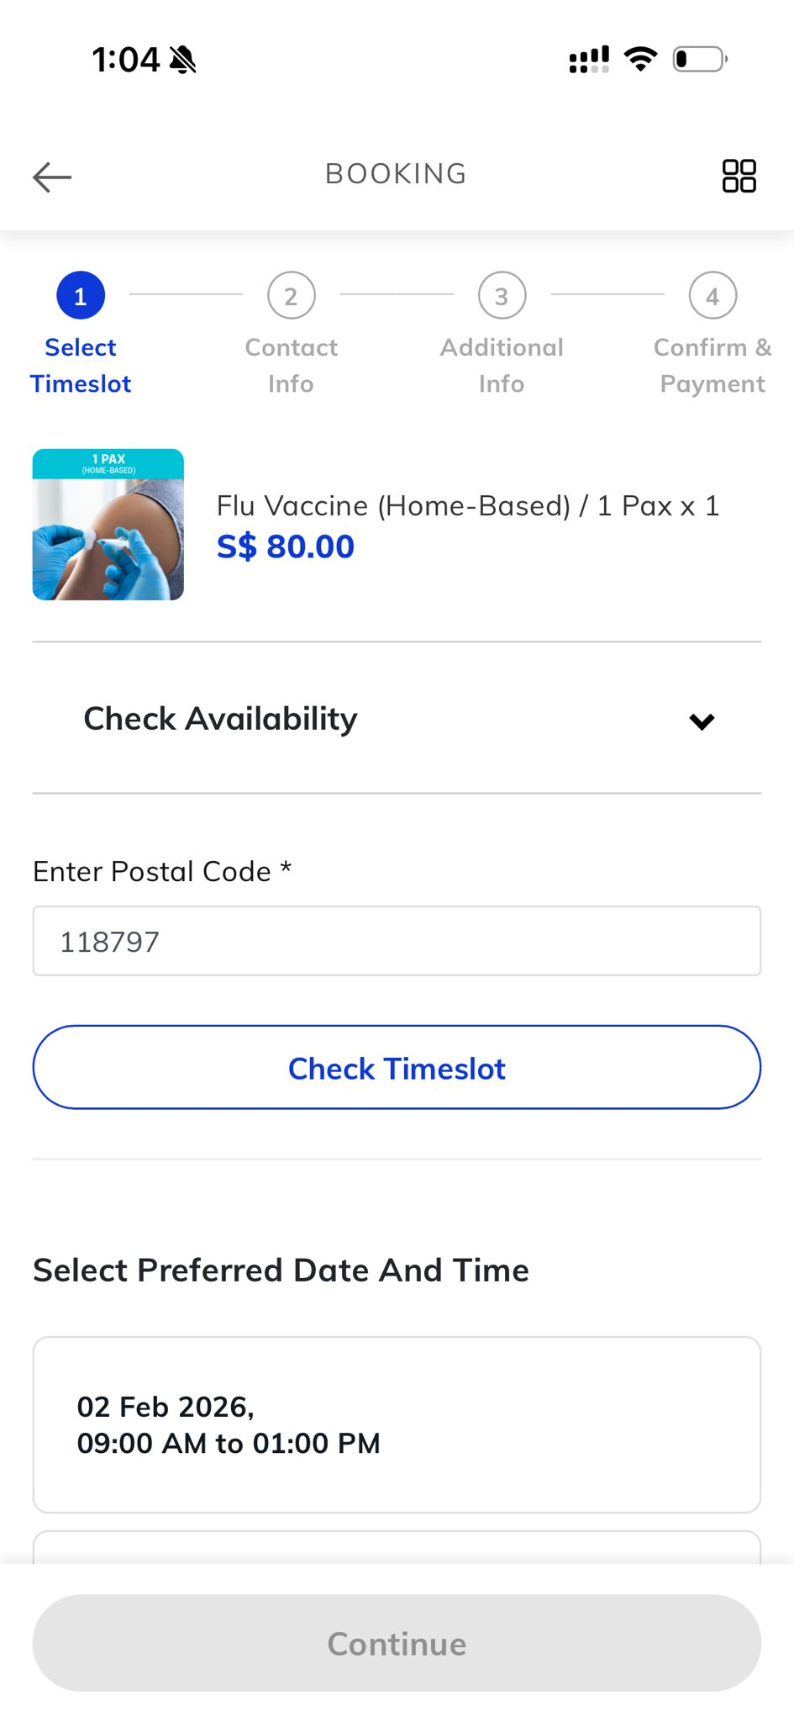
VACCINATION USER JOURNEY- IN APP
DA Market Place
Booked via DA Marketplace (mobile web)
Service delivered in clinic or home
Primary objective: Completed booking
Recommended lead channel: Web Conversion

Slide 7
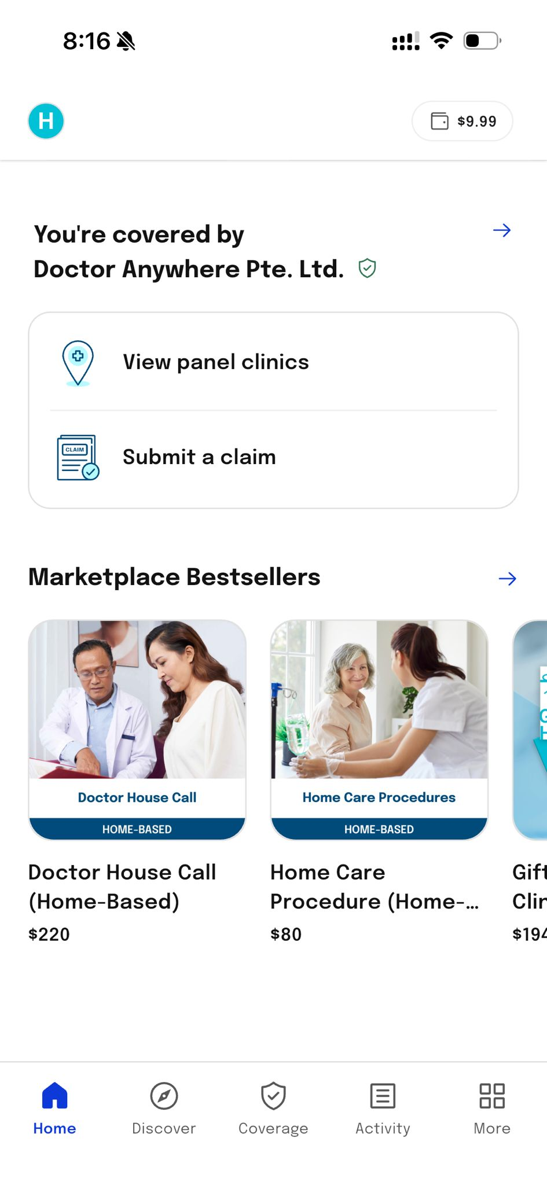
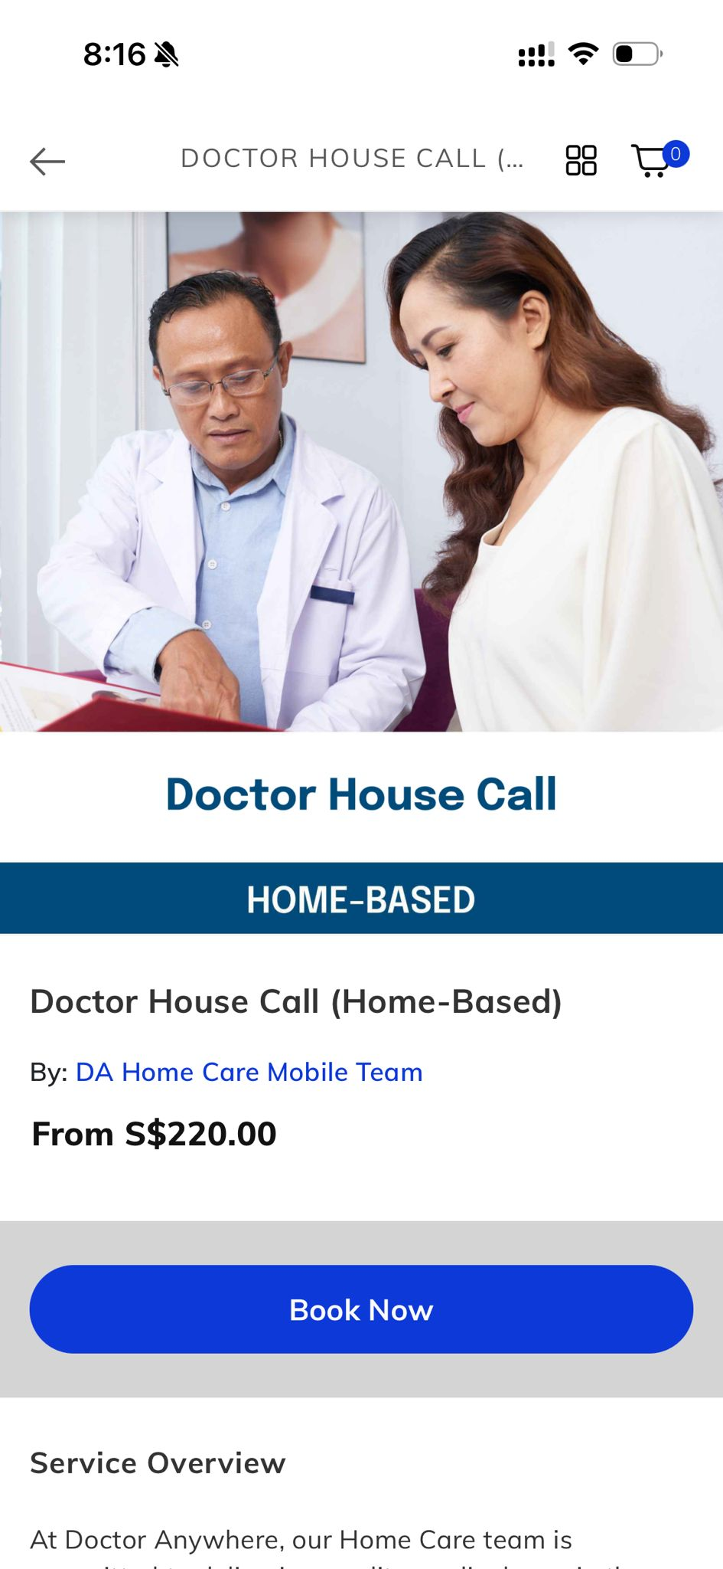
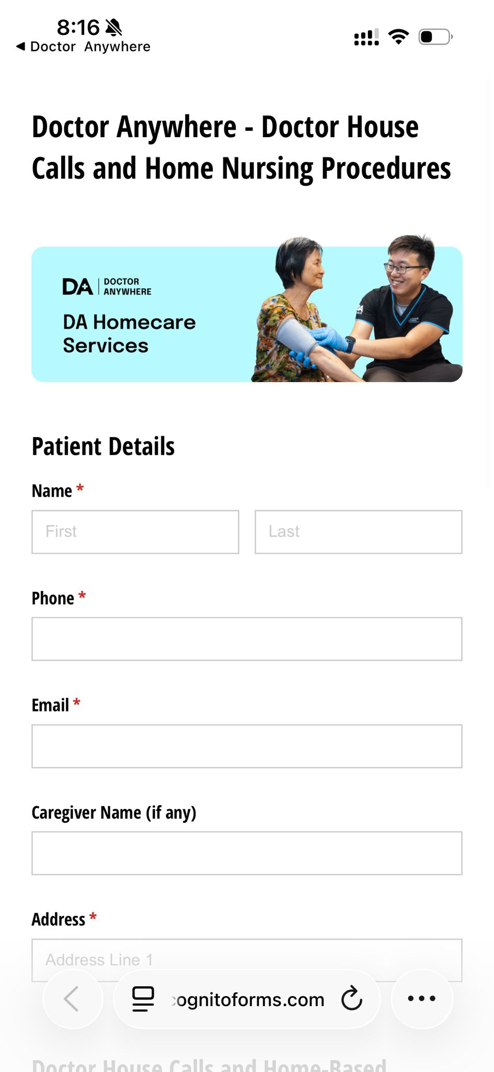
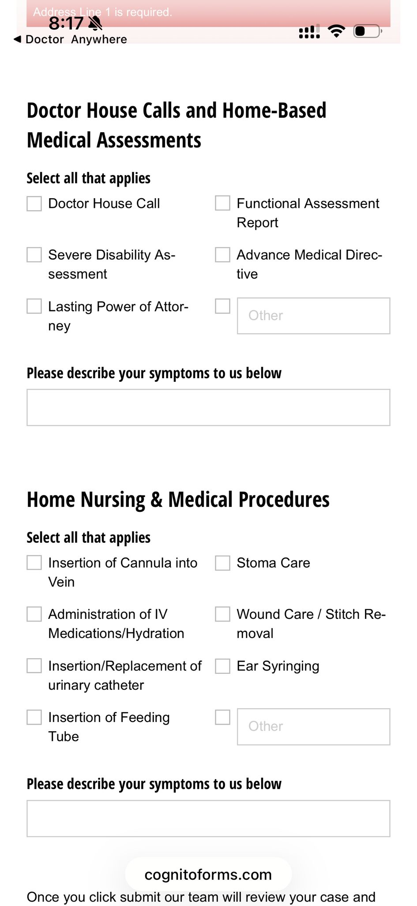
HOME BASED (DOCTOR HOUSE CALL)
DA Market Place
Booked via DA Marketplace → web form (incognito) Service delivered offline
Primary objective: Completed booking request Recommended lead channel: Web Conversion

Slide 8
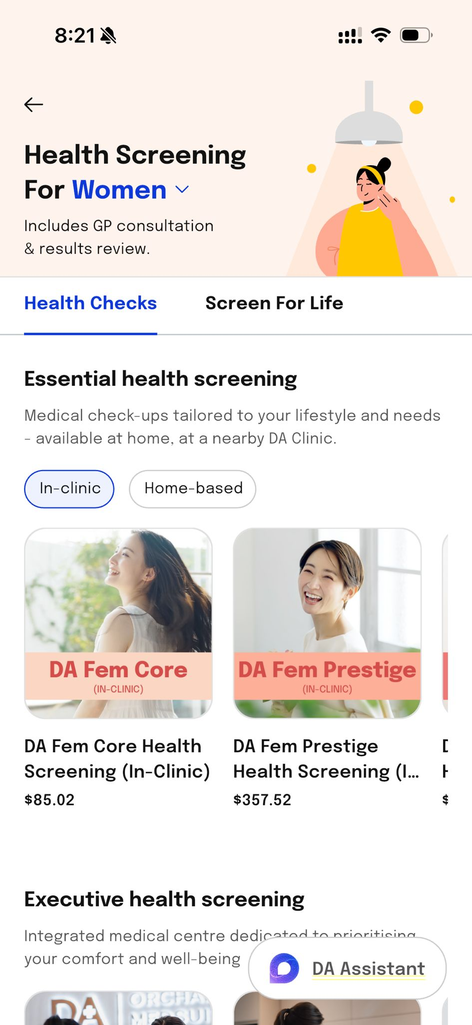
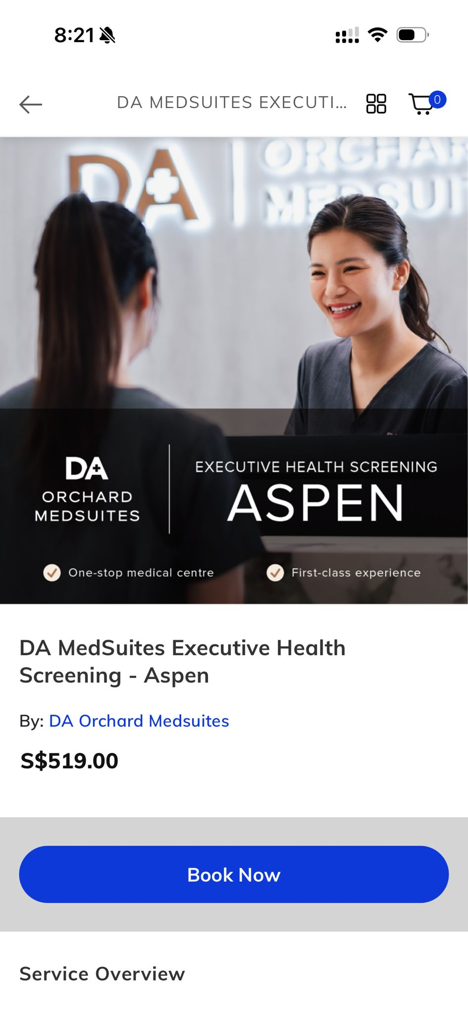
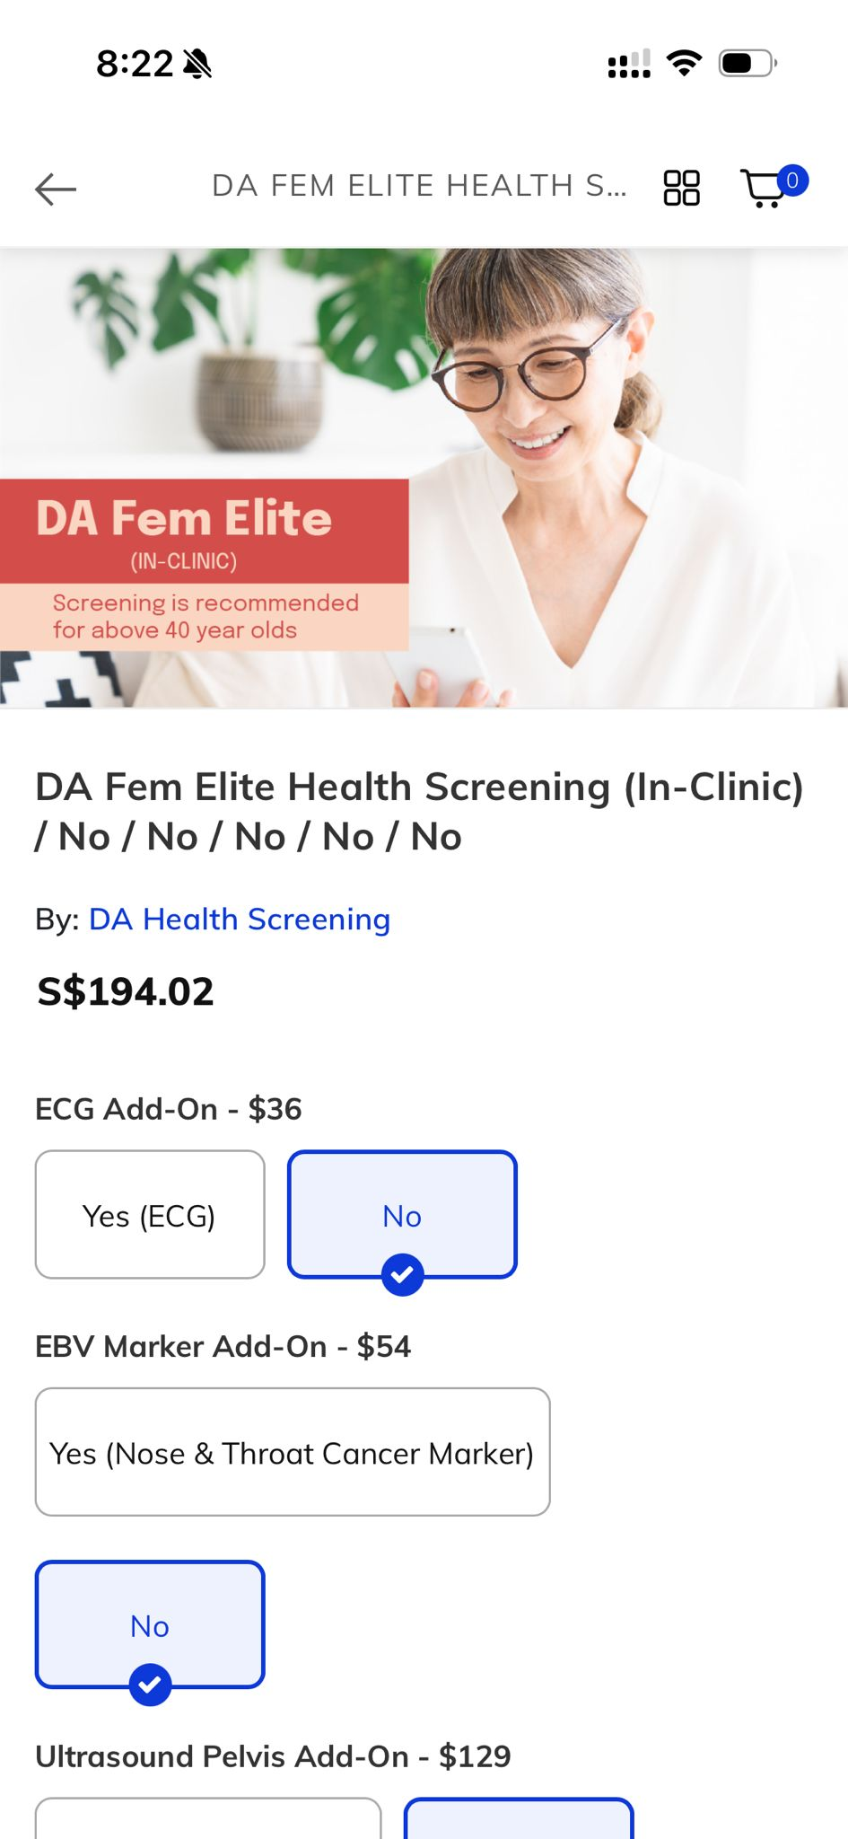
HEALTH SCREENING
DA Market Place
Booked via web form / DA Marketplace Service delivered in clinic or home
Primary objective: Qualified booking form submission Recommended lead channel: Web Conversion

Slide 9
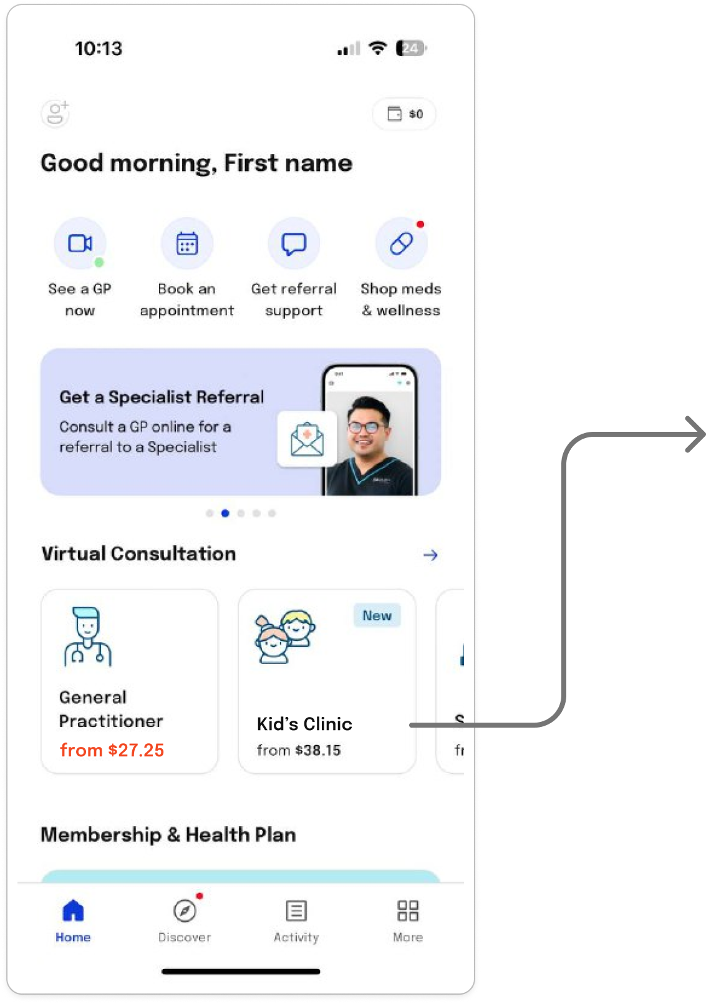
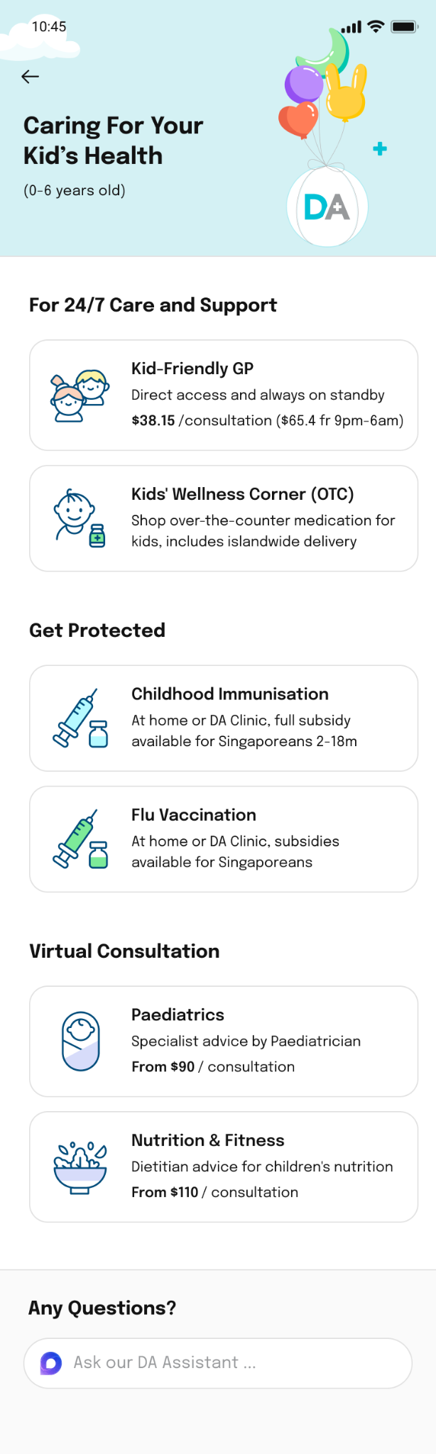
KIDS CLINIC USER JOURNEY- IN APP
ttps://doctoranywhere.sng.link/Avkkq/9v17/r8a4
VC journey
DA Market place journy
Vaccination journey
VC journey

Slide 10
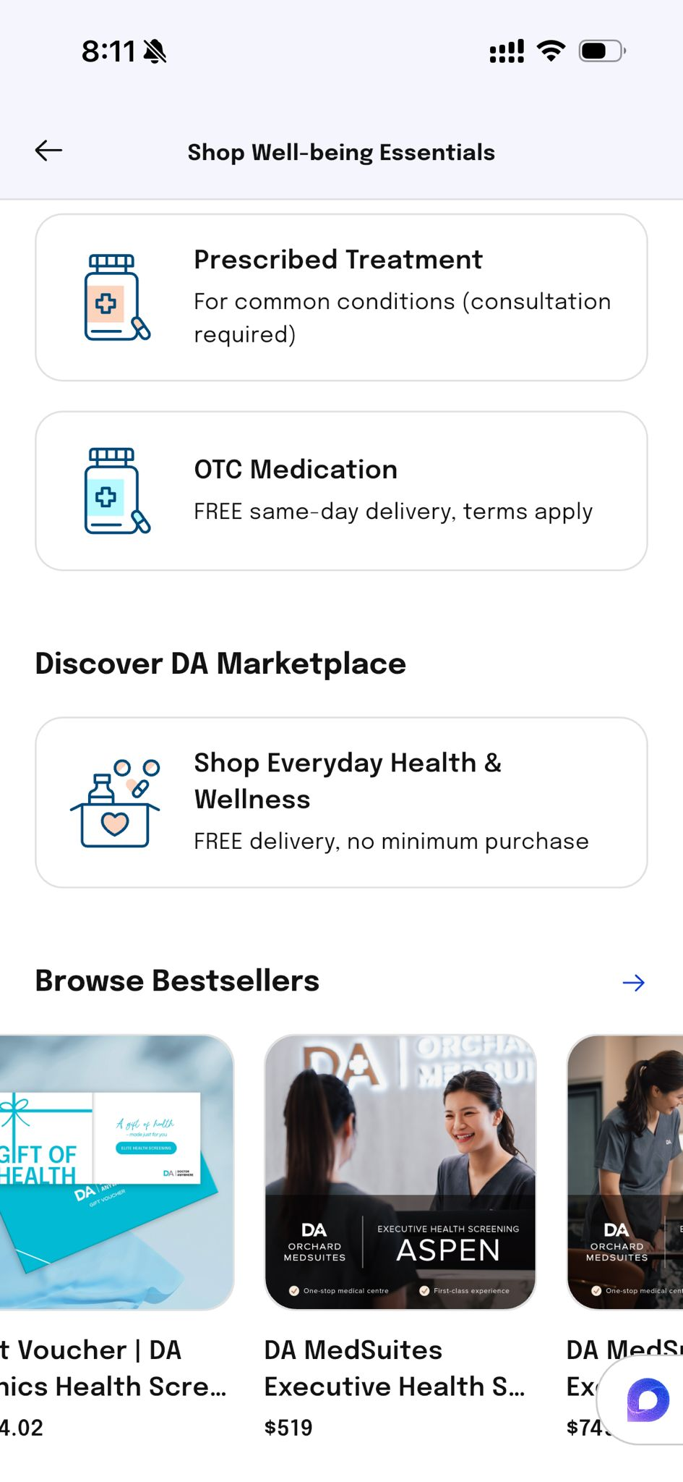
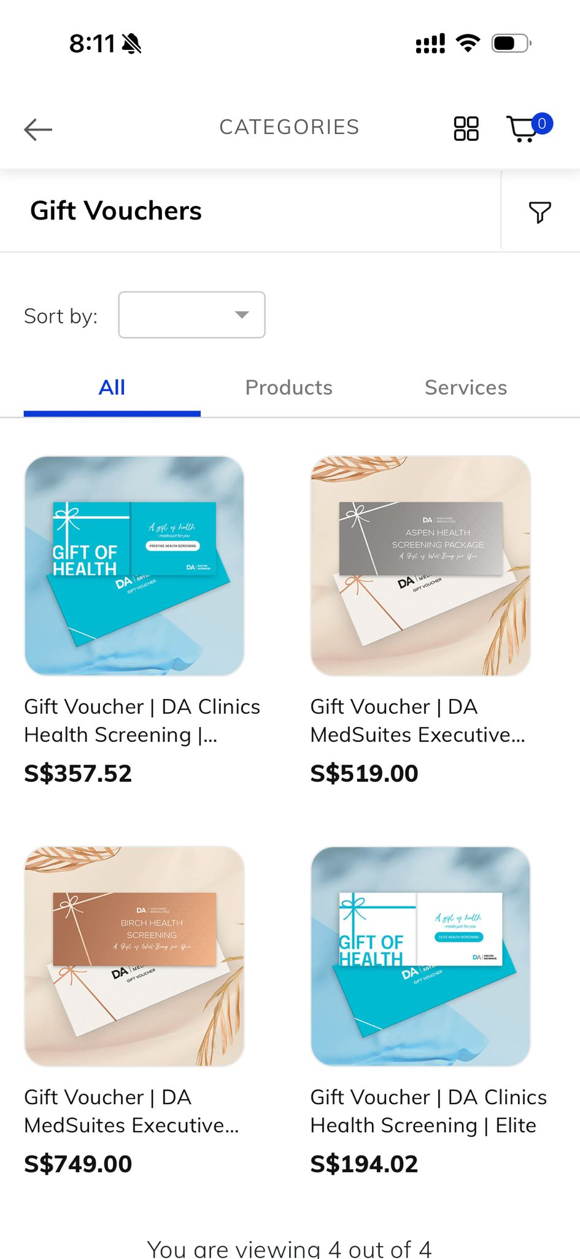
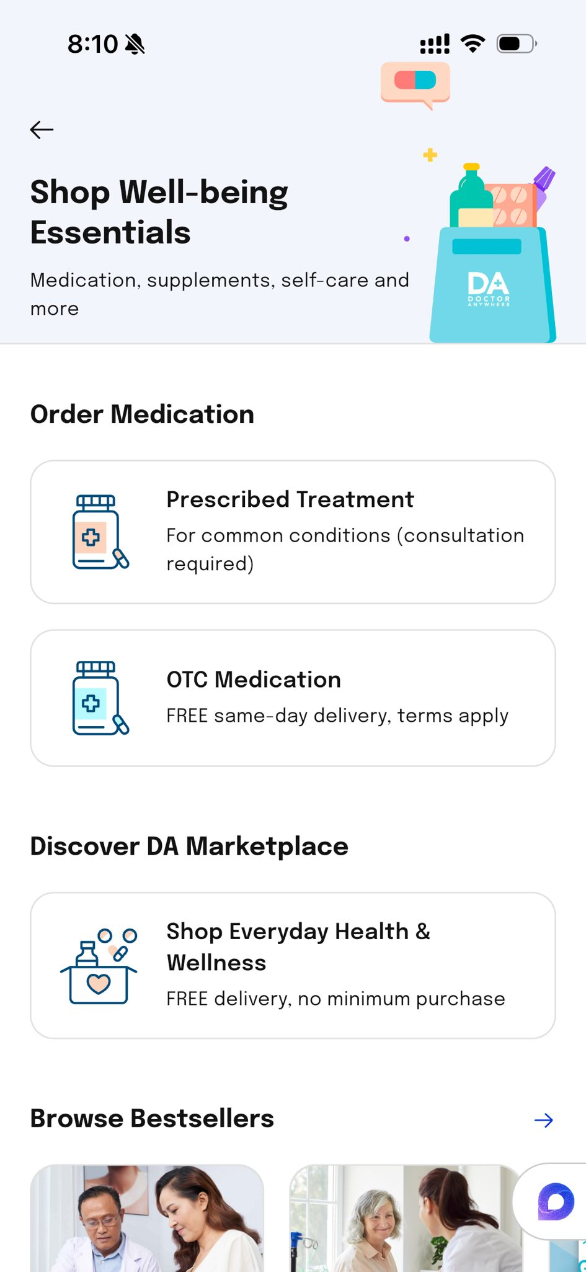
DA MARKET PLACE (MOBILE WEB)

Slide 11
WEB
https://doctoranywhere.com/

Slide 12
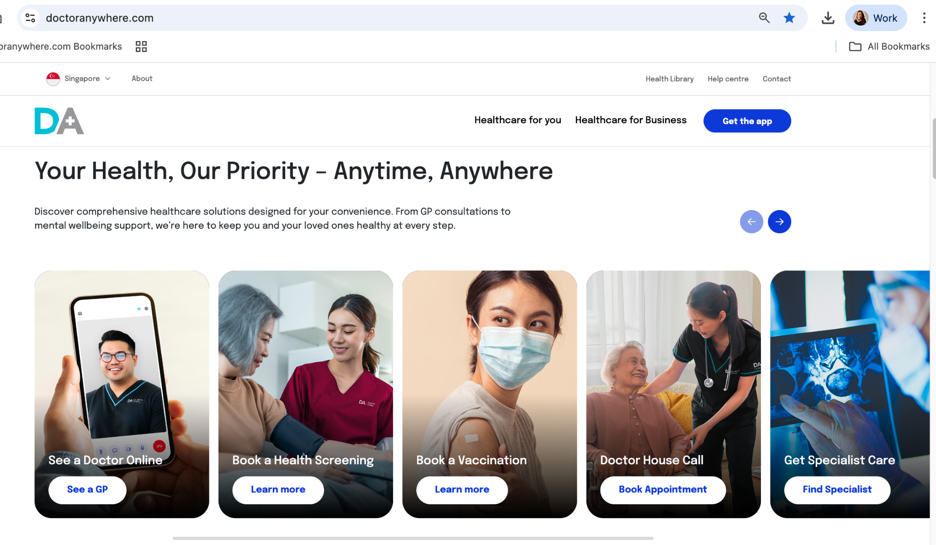
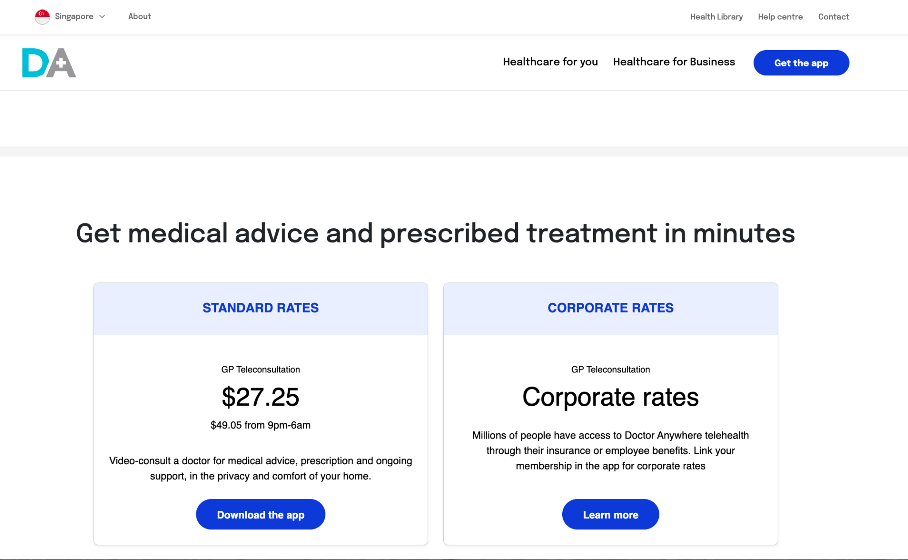
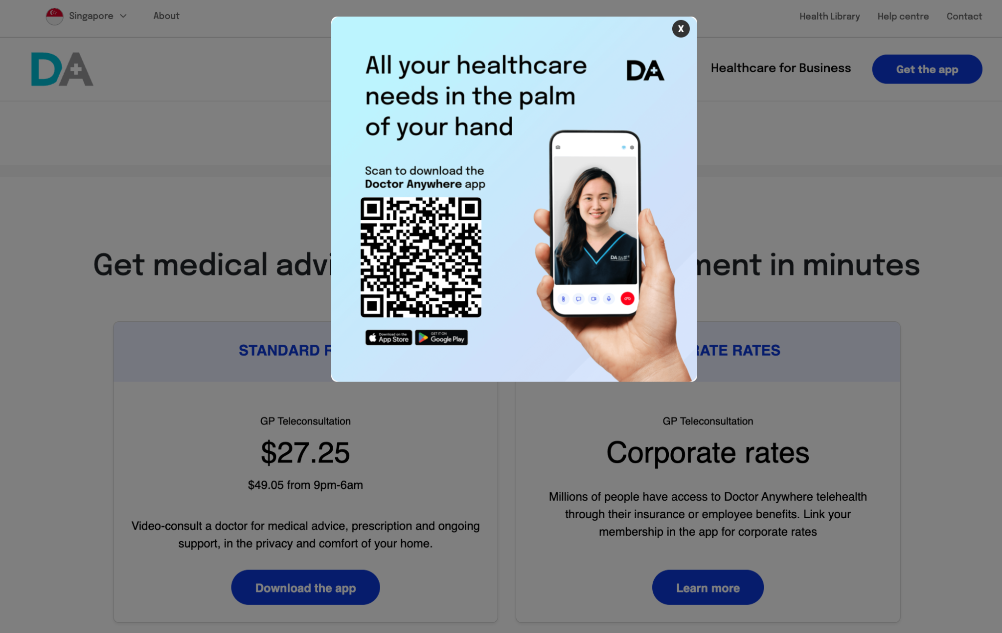
VIRTUAL CONSULT
Web

Slide 13
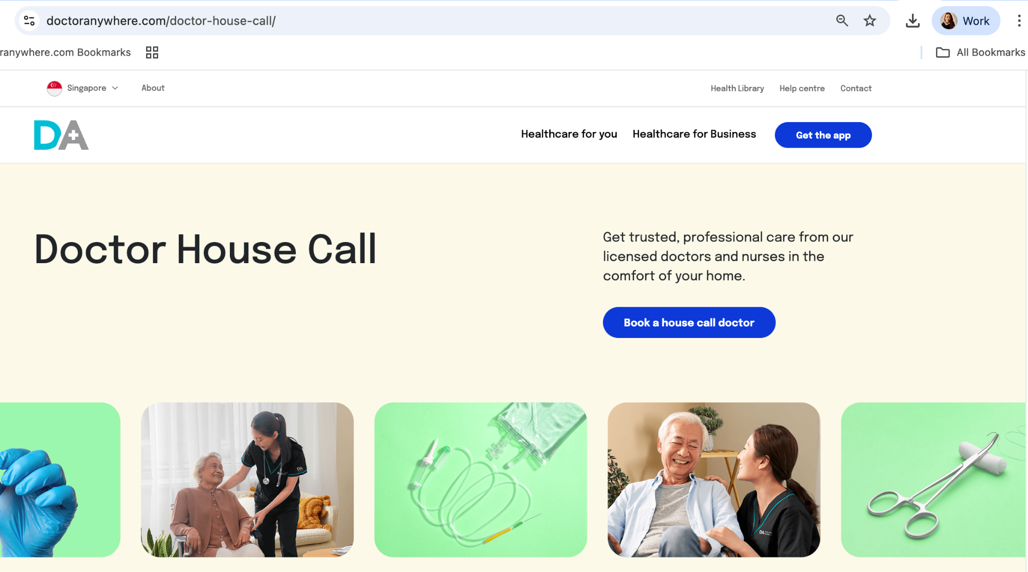
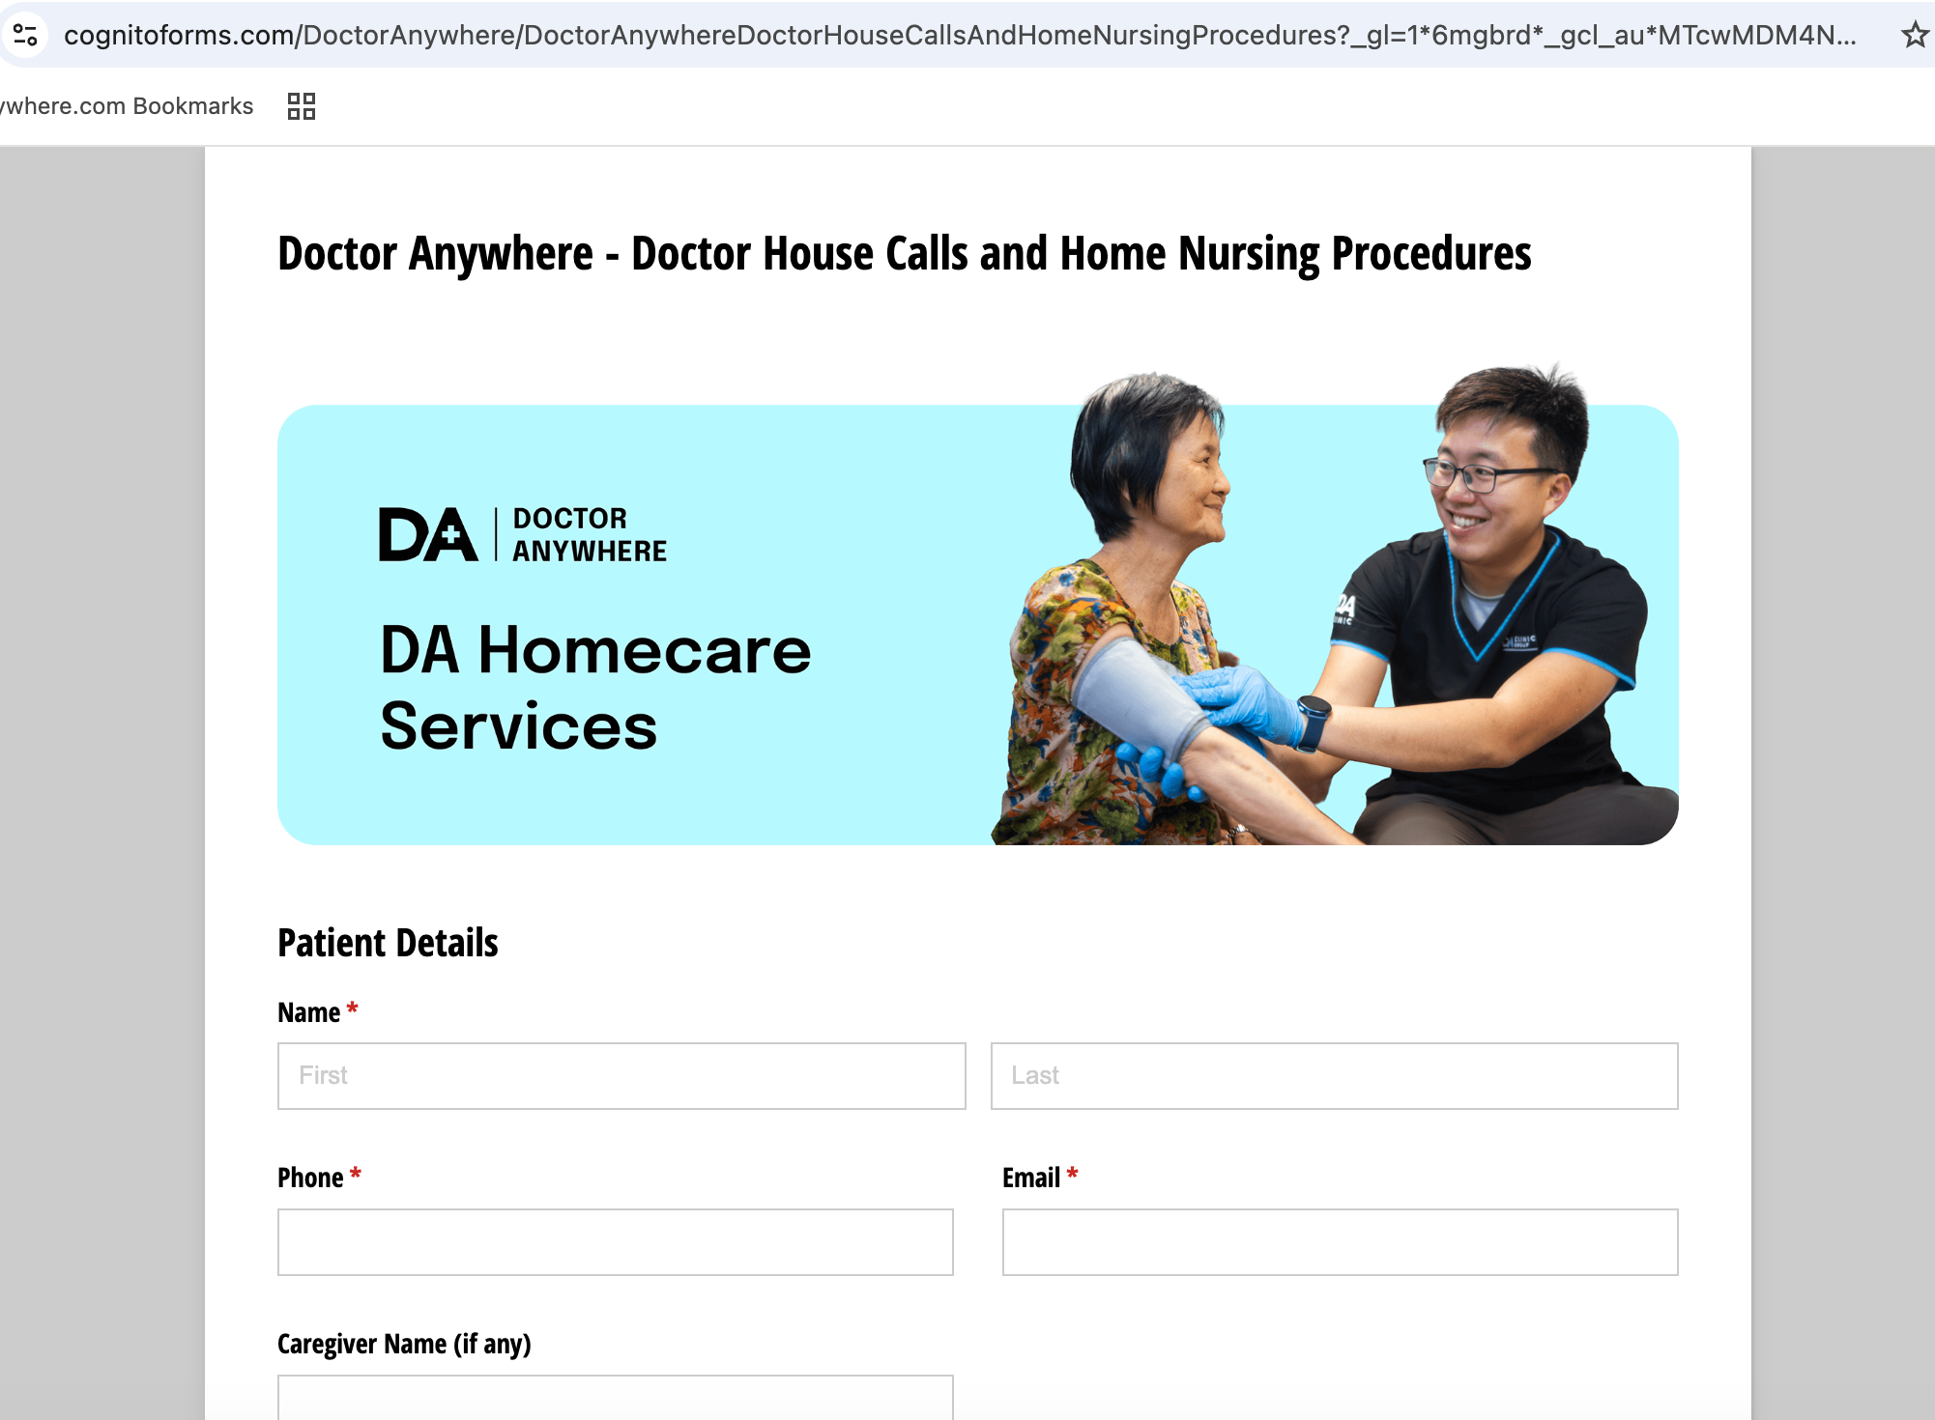
DOCTOR HOUSE CALL
Web

Slide 14
PAID MEDIA ATTRIBUTION:
Drive users to the channel where value is delivered and attribution is clean — not where it’s convenient to send traffic.
This means:
VC → App install (new users)
VC → Current users with app → REMIND → web URL
All other services → Web (mobile web / DA Marketplace)
Service | Where service is delivered | Lead Conversion Channel | Why this wins
Virtual Consult (VC) | App | App Install → VC completed | Closed-loop journey, fastest time-to-care, strongest signal quality
Vaccination | In-clinic / Home-based | Web Conversion (DA Marketplace) | High-consideration, content-heavy, booking happens on web
Health Screening | In-clinic / Home-based | Web Conversion (Form / Marketplace) | Package comparison + intent validation best handled on web
Home-Based Care (Doctor House Call) | Offline | Web Conversion (Booking Form) | Urgent, intent-led; app install adds friction without delivery benefit

